Slide 1
KAFKA
Distributed event streaming platform.

Slide 2
AGENDA
What is Kafka? [distributed “event streaming” platform]
Why Kafka? How can we use Kafka?
Kafka Architecture
Components of Kafka
Features of Kafka
Installation and Setup
Kafka Messaging [Producer/Consumer]
Kafka Connectors [Sink and Source]
Kafka Streaming [Apache Spark]

Slide 3
Problem Statement
A common problem faced by many modern applications: handling high volumes of data and ensuring reliable communication between different components of a distributed system. We can’t achieve this by using RDBMS.
Handling High Volumes of Data:
Modern applications generate and process vast amounts of data in real-time. Traditional messaging systems may struggle to handle the volume and velocity of data efficiently.
Reliable Communication:
In a distributed system, different components need to communicate with each other reliably. This includes sending messages, handling failures gracefully, and ensuring that messages are delivered in the correct order.

Slide 4
Solution
1. Handling High Volumes of Data:
Example: Consider a social media platform where users generate a large number of posts, comments, likes, and other interactions every second.
Problem: Traditional messaging systems may struggle to handle the volume and velocity of data generated by users.
Solution with Kafka: Kafka's distributed architecture allows it to handle massive amounts of data efficiently. It partitions data across multiple brokers and scales horizontally to accommodate high throughput.
2. Reliable Communication:
Example: In a ride-sharing service like Uber, it's crucial for drivers and riders to communicate and coordinate in real-time.
Problem: Traditional messaging systems may not provide the reliability and fault tolerance needed for real-time communication in a distributed environment.
Solution with Kafka: Kafka ensures reliable communication by providing features such as message persistence, replication, and fault tolerance. Messages are persisted to disk and replicated across multiple brokers to prevent data loss, even in the event of failures.

Slide 5
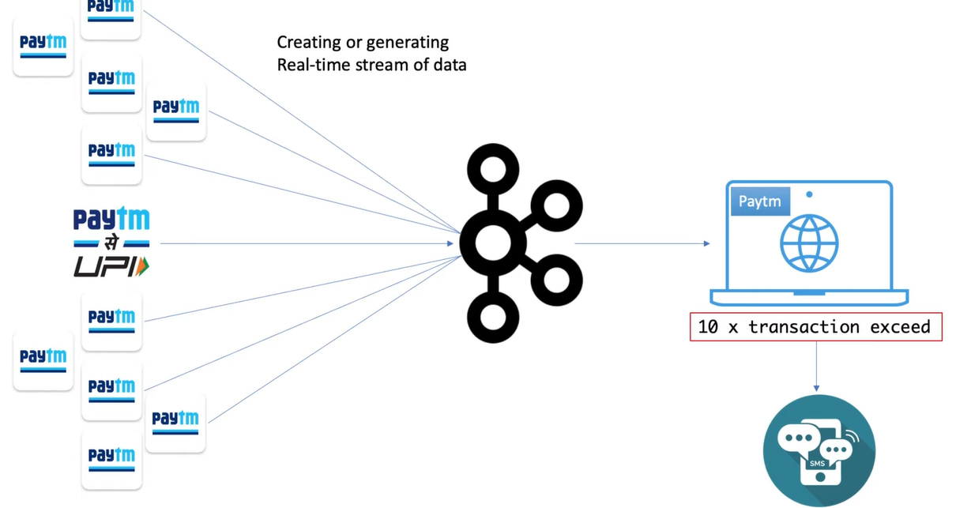

Slide 6
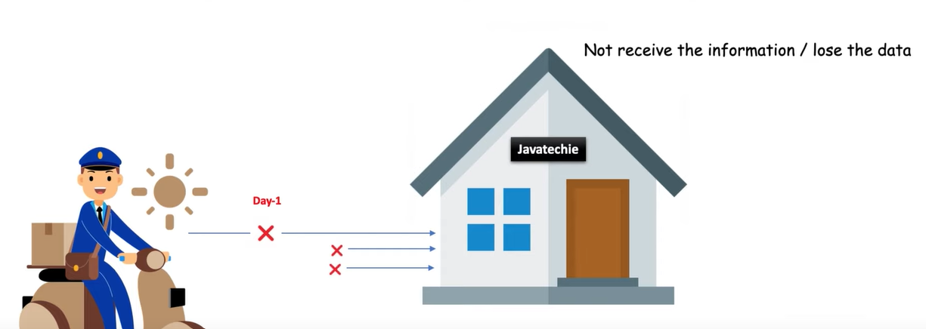
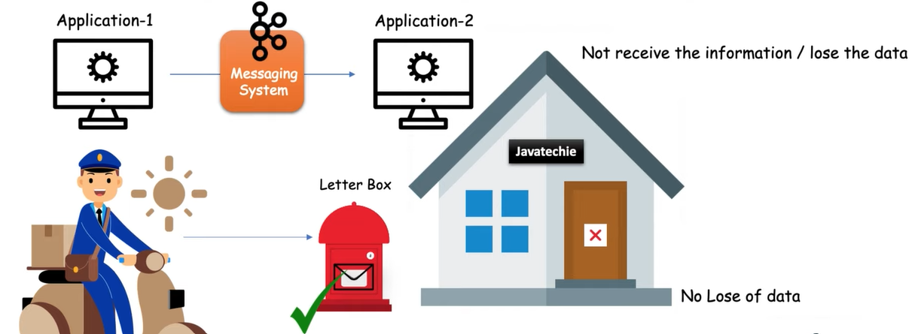

Slide 7
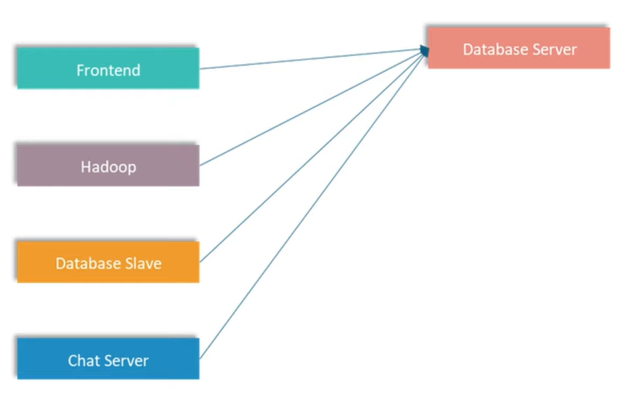
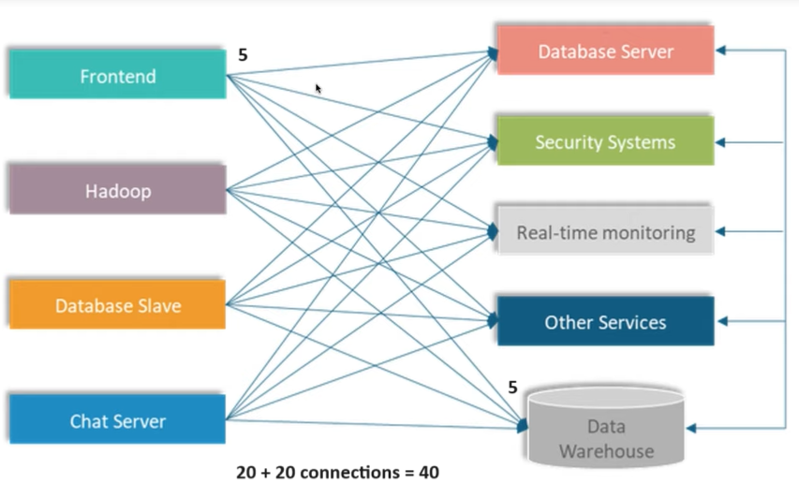

Slide 8
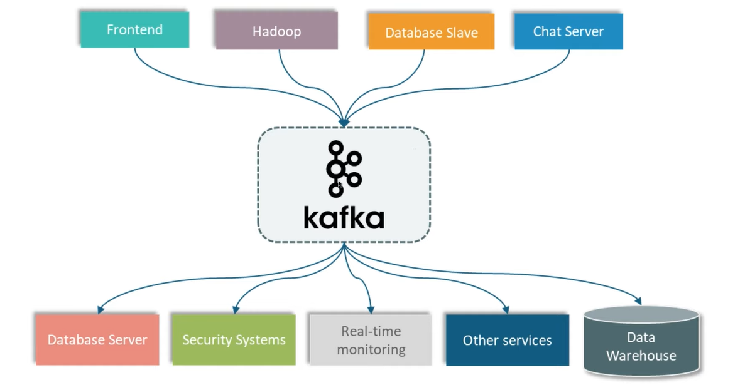

Slide 9
KAFKA: Components
Producer:
Producers are applications that publish data to Kafka topics.
Examples: Web servers, IoT devices, log files, etc.
Ex, a web server producing website activity logs and sending them to Kafka for processing.
Topic: [like table in database]
A topic is a category or stream of messages in Kafka.
Topics are divided into partitions to allow parallel processing and scalability.
Each message within a topic is identified by its offset.
Example: "WebsiteLogs", "UserActivity", "SensorData".

Slide 10
Partition:
Each topic is divided into one or more partitions.
Partitions allow messages within a topic to be distributed across multiple brokers for parallel processing.
Each message is assigned a sequential offset within its partition.
Example: "Website Logs" topic may have partitions 0, 1, and 2 to distribute the workload.
Broker:
Brokers are servers that form the Kafka cluster.
Each broker stores one or more partitions of Kafka topics.
Brokers handle message storage, replication, and distribution.
Example: Kafka server instances running on separate machines or nodes in a cluster.
Consumer Group:
Consumers are applications that subscribe to Kafka topics and process messages.
Consumers work together in consumer groups to read from different partitions of a topic in parallel.
Each message in a partition is consumed by only one consumer within a group.
Example: Real-time analytics applications, microservices, data processing pipelines.

Slide 11
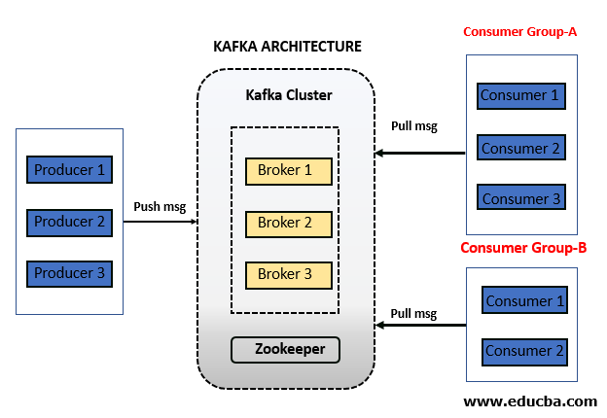

Slide 12
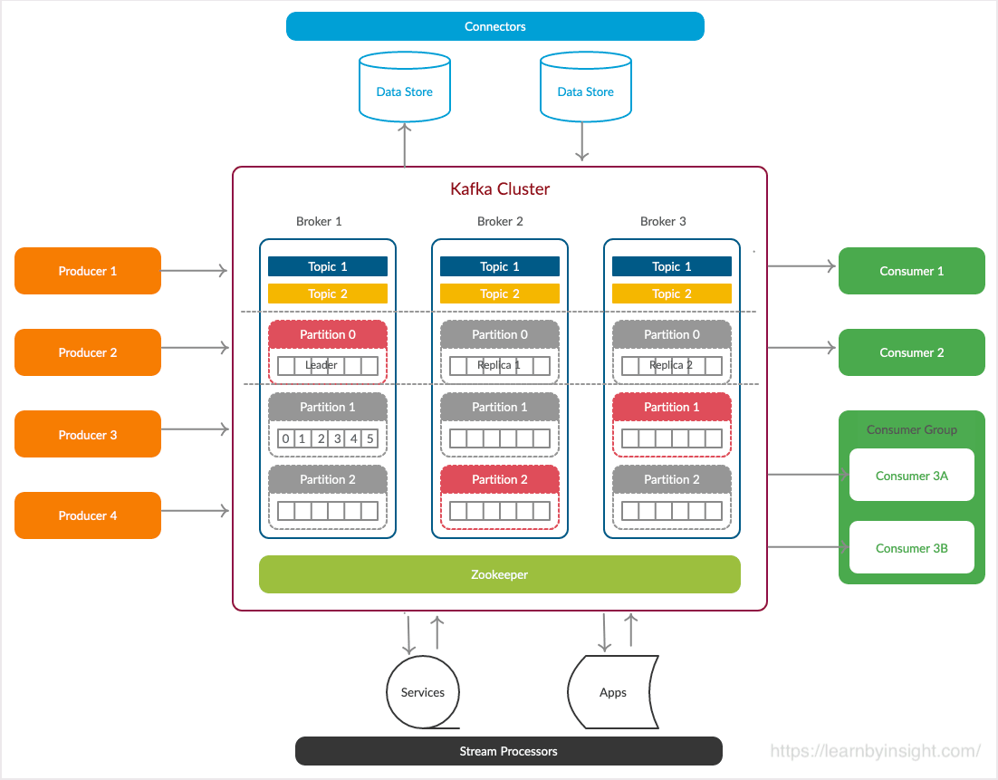

Slide 13
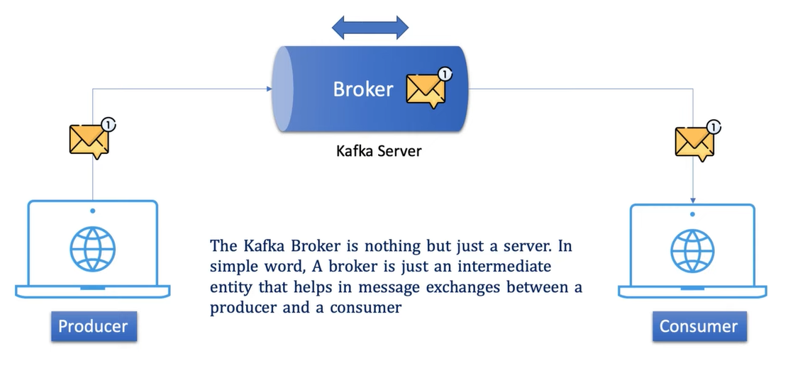
PUB/SUB Model

Slide 14
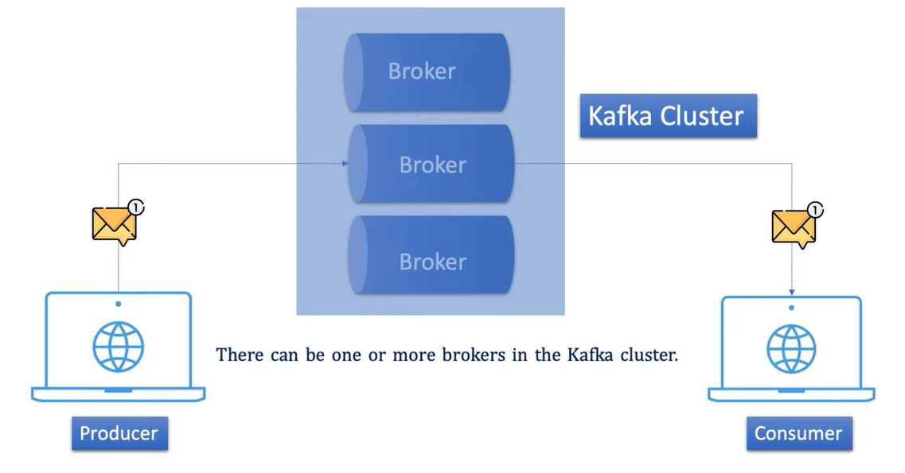

Slide 15
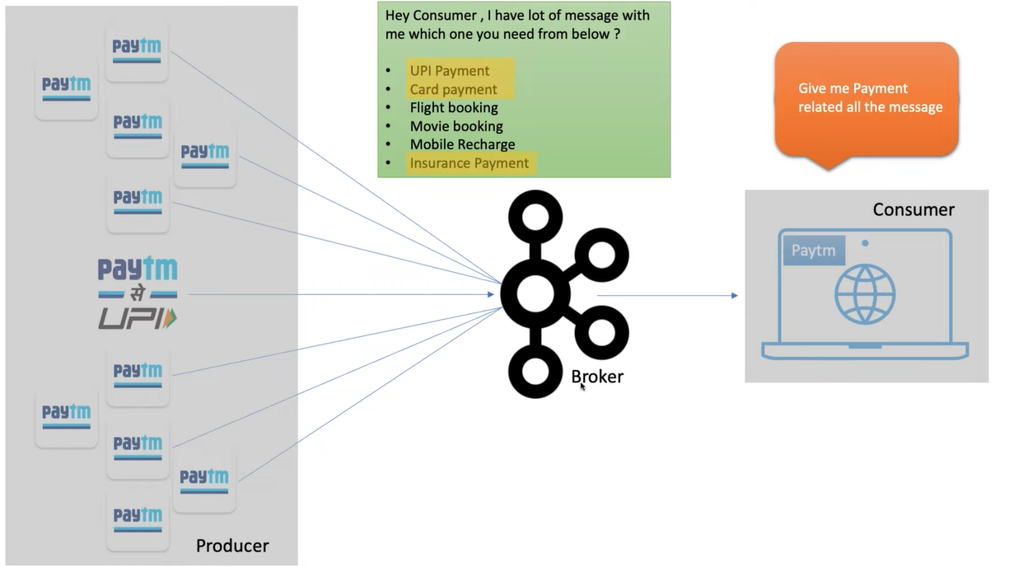

Slide 16
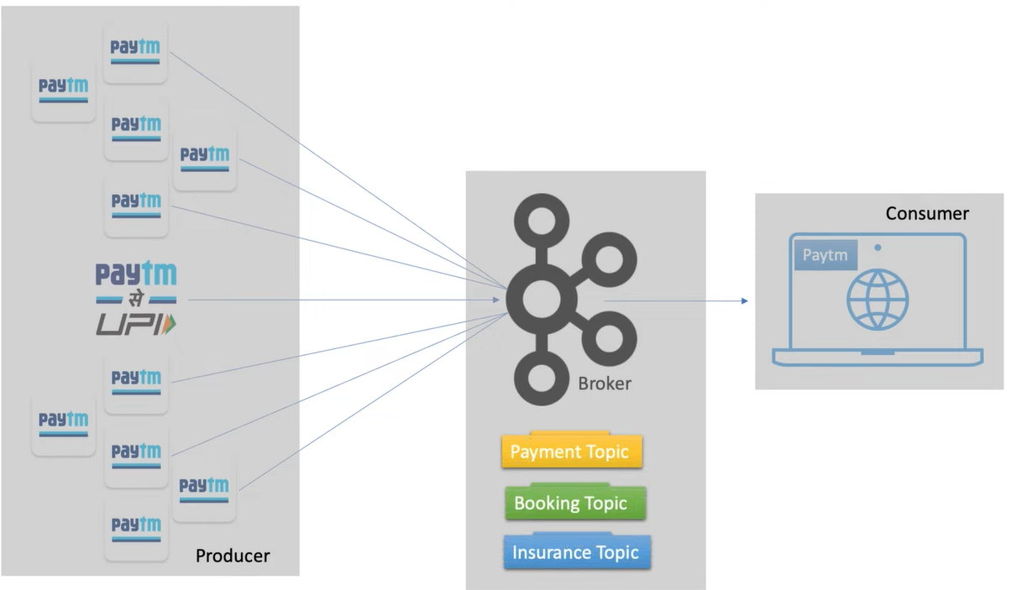

Slide 17
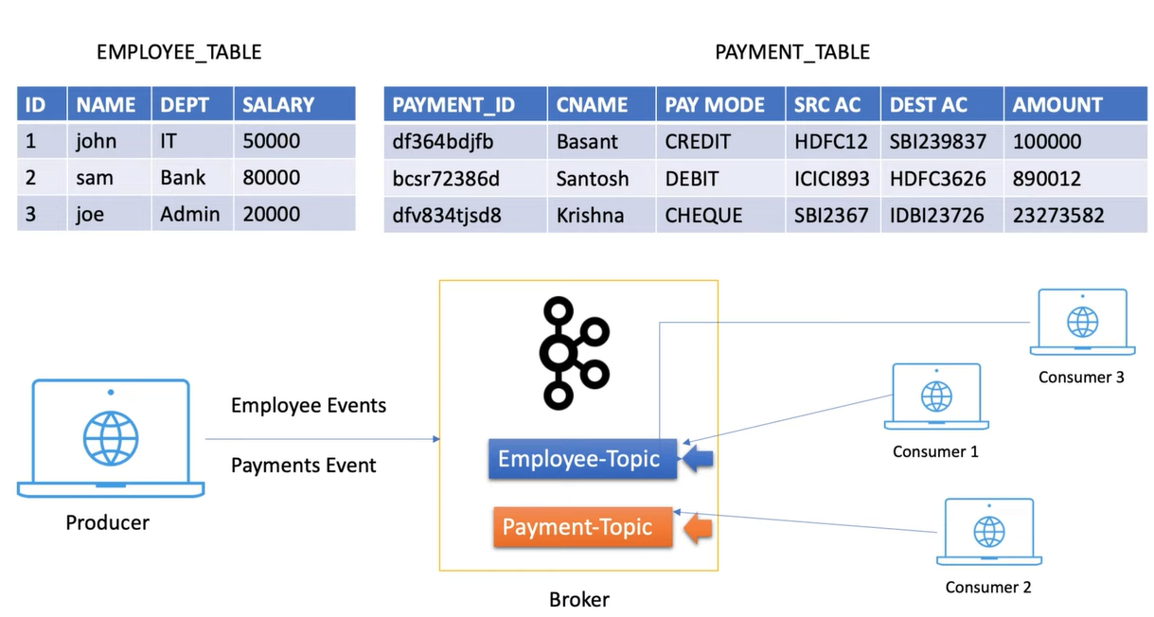

Slide 18
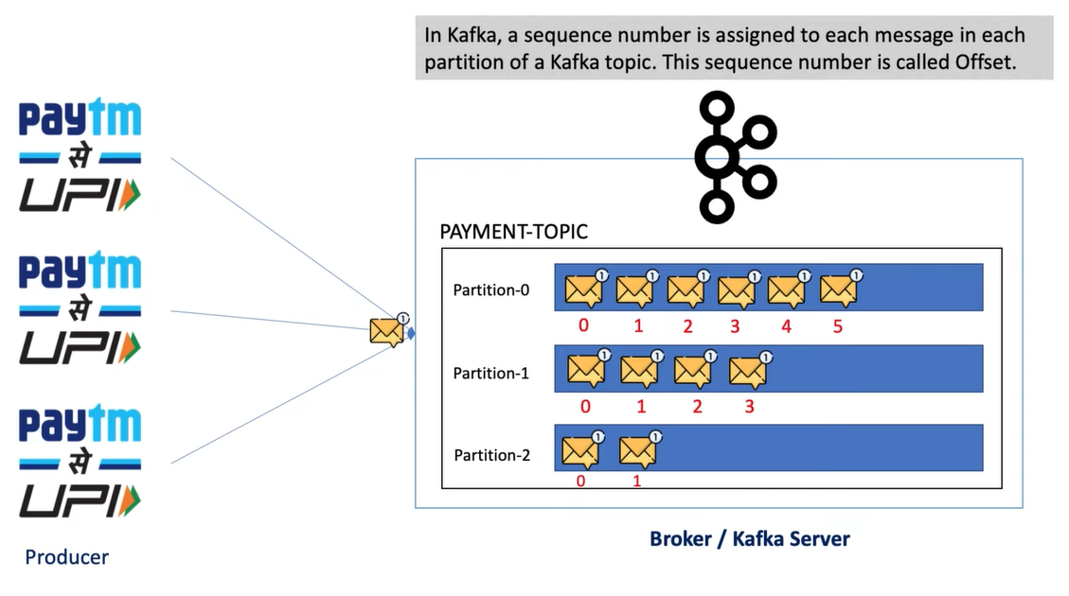
If consumer is down after reading message at offset 3, then that consumer will start reading from offset 4, whenever it starts.

Slide 19
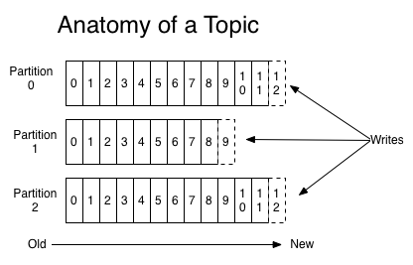
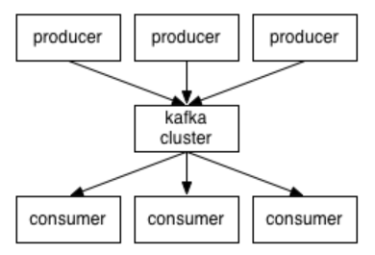
Applications (producers) send messages (records) to a Kafka node (broker) and said messages are processed by other applications called consumers. Said messages get stored in a topic and consumers subscribe to the topic to receive new messages.
As topics can get quite big, they get split into partitions of a smaller size for better performance and scalability.

Slide 20
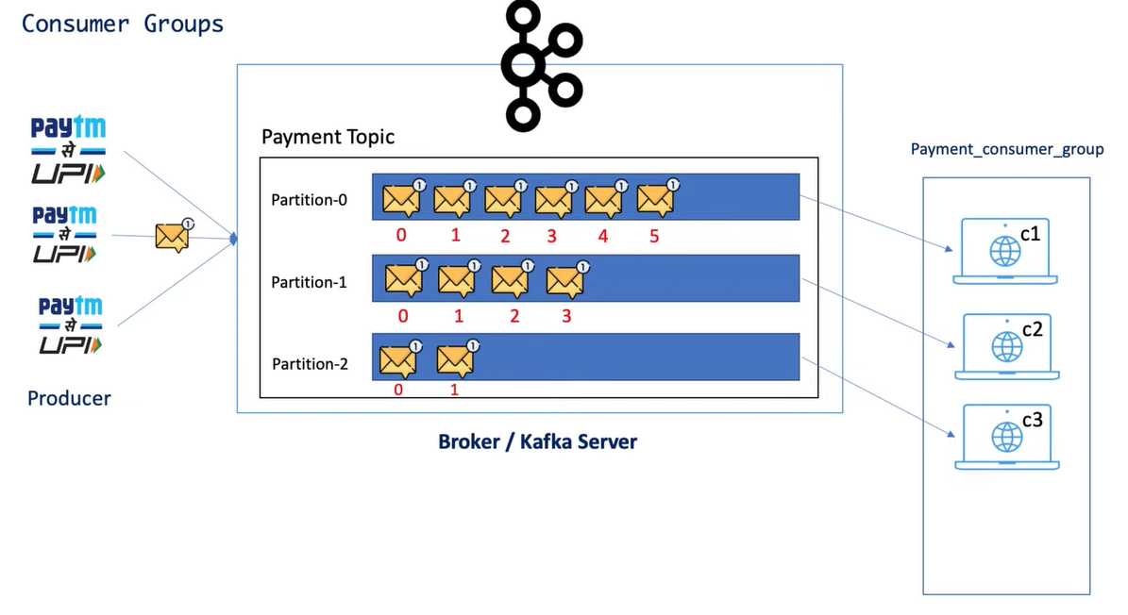
Consumer 1 is reading from partition-0, and so on. If consumer 4 is added then it will wait for other partition.

Slide 21
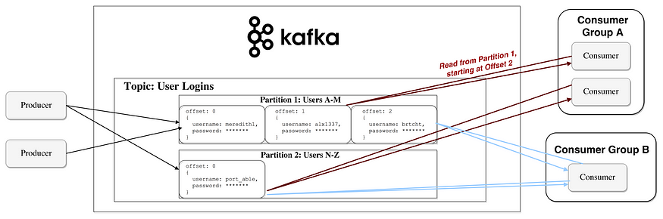
It’s worth noting consumers are actually consumer groups that have one or more consumer processes inside. In order to avoid two processes reading the same message twice, each partition is tied to only one consumer process per group.*

Slide 22
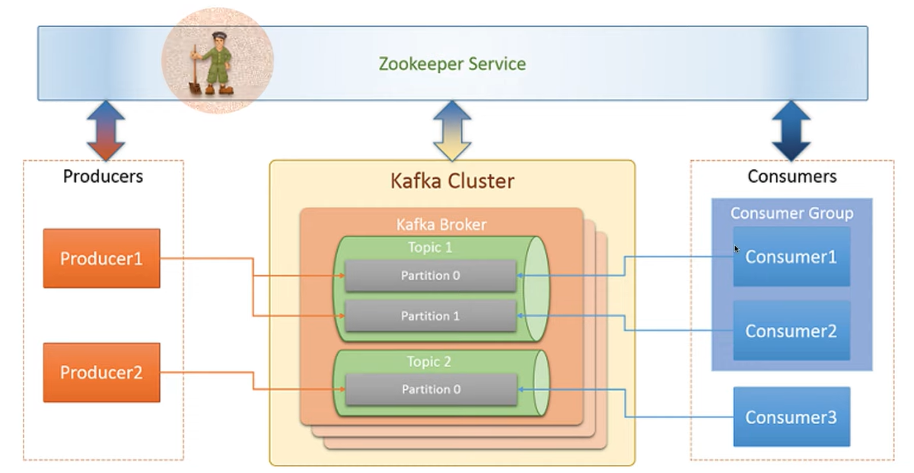

Slide 23
Real-World Example: Uber
1. Tracking Driver Locations:
Producers (Drivers): The drivers' mobile apps act as producers that continuously send updates about their GPS location to Kafka.
Topics (Driver Locations): Kafka topics are used to store real-time updates of driver locations. Each driver's location update is a message in the topic.
Consumers (Dispatcher, Rider App): The dispatcher system and rider app act as consumers that subscribe to the driver locations topic to track nearby drivers.
2. Handling Customer Requests:
Producers (Rider App): When a rider requests a ride, the rider app sends a ride request message to Kafka.
Topics (Ride Requests): Kafka topics are used to store ride requests from riders. Each ride request is a message in the topic.
Consumers (Dispatcher, Drivers): The dispatcher system consumes ride request messages and assigns them to available drivers based on their current locations and ride preferences.

Slide 24
3. Facilitating Communication:
Topics (Driver-Rider Communication): Kafka topics can be used to facilitate communication between drivers and riders during the ride. Messages related to ride updates, pickup locations, drop-off points, and other notifications are exchanged through Kafka.
Consumers (Drivers, Riders): Both drivers and riders subscribe to relevant topics to receive real-time updates and notifications about the ride status.
4. Benefits of Kafka:
Real-Time Tracking: Kafka enables real-time tracking of driver locations and ride requests, allowing for efficient matching of drivers and riders.
Scalability: Kafka's distributed architecture can handle high volumes of messages and ensure that data is processed and delivered reliably.
Fault Tolerance: Kafka provides fault tolerance and data replication, ensuring that messages are not lost even in the event of failures or network issues.
Flexibility: Kafka's pub-sub model allows for decoupling of components, making it easy to add new features and scale the system as needed.

Slide 25
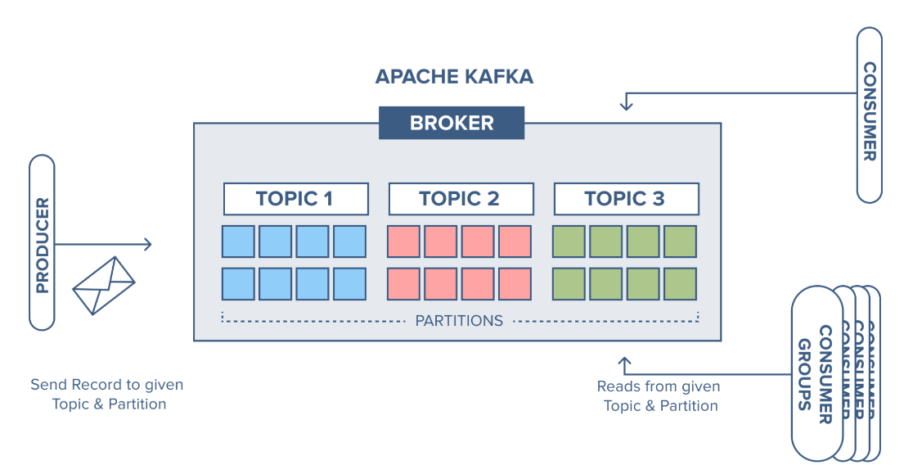
We have an example, where we have a broker with three topics, where each topic has 8 partitions. [T1:invoices, T2:orders and T3:reports]

Slide 26
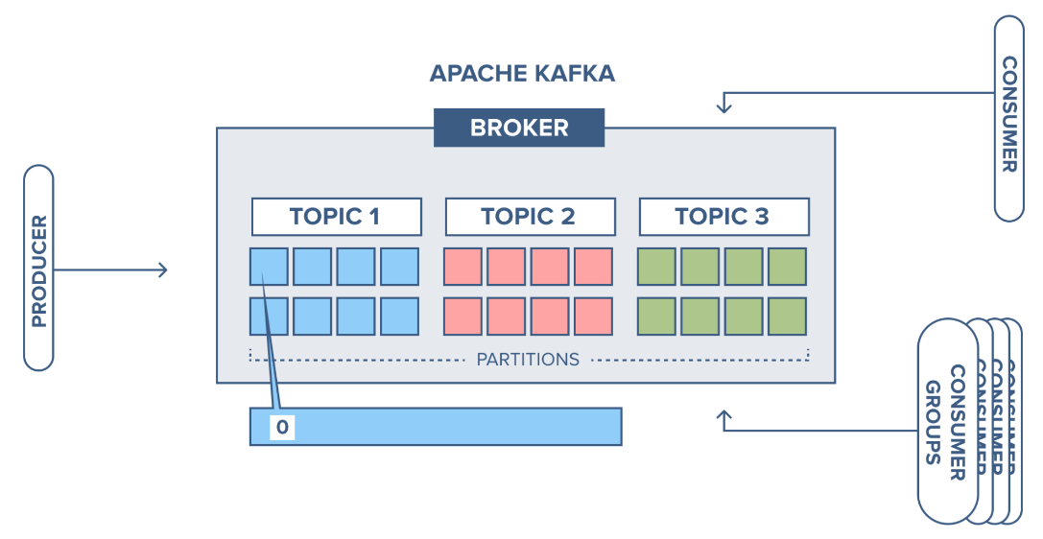
The producer sends a record to partition 1 in topic 1(invoices) and since the partition is empty the record ends up at offset 0.

Slide 27
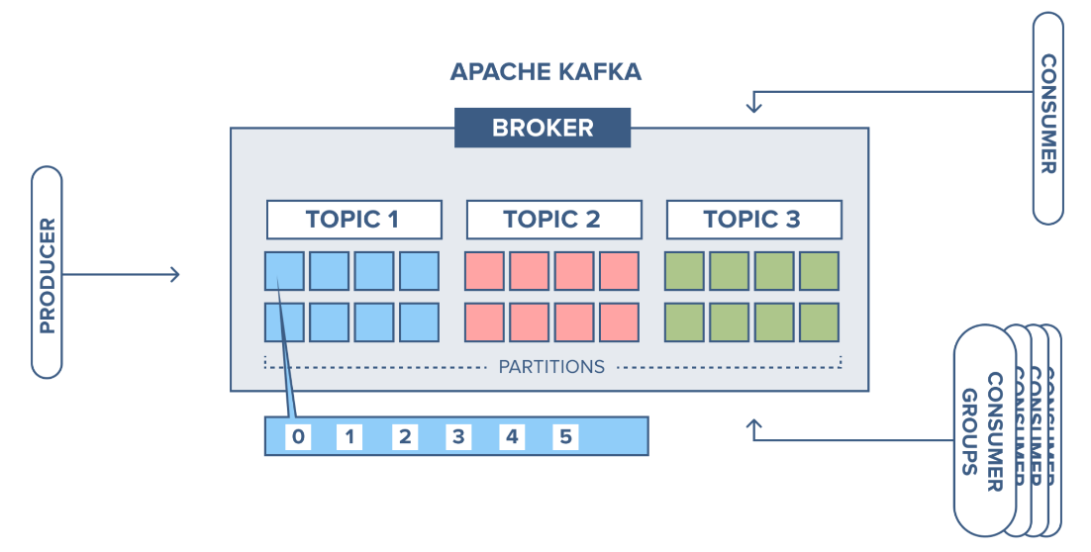
The next record is added to partition 1 will and up at offset 1, and the next record at offset 2, and so on.

Slide 28
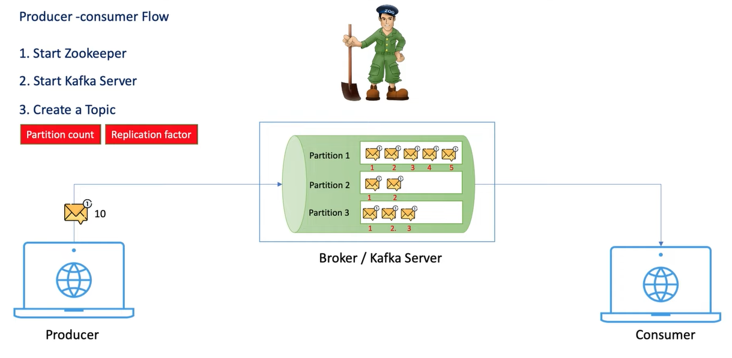
KAFKA Installation (Apache vs Confluent)

Slide 29
Demo-1: Kafka CLI
Start the zookeeper [2181]
cmd> .\bin\windows\zookeeper-server-start.bat .\config\zookeeper.properties
Start Kafka Server [9092]
cmd> .\bin\windows\kafka-server-start.bat .\config\server.properties
Create Kafka Topic
bin\windows\kafka-topics.bat --bootstrap-server localhost:9092 --create --topic your_topic_name --partitions 3 --replication-factor 1
Kafka Producer
.\bin\windows\kafka-console-producer.bat --broker-list localhost:9092 --topic dummy-topic
Kafka Consumer
.\bin\windows\kafka-console-consumer.bat --bootstrap-server localhost:9092 --topic dummy-topic --from-beginning

Slide 30
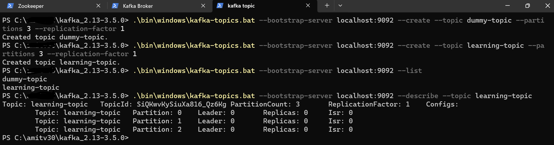

Slide 31
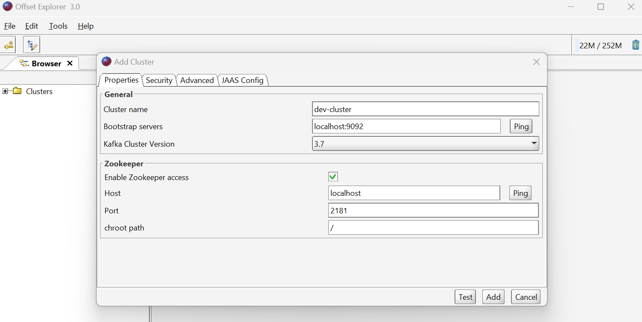
Offset Explorer

Slide 32
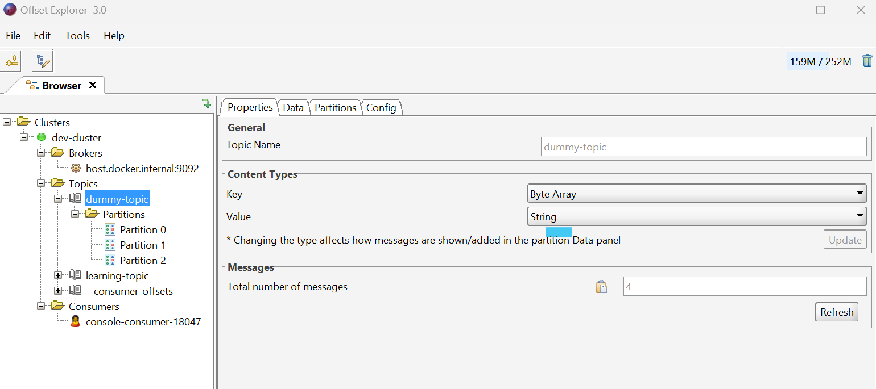

Slide 33
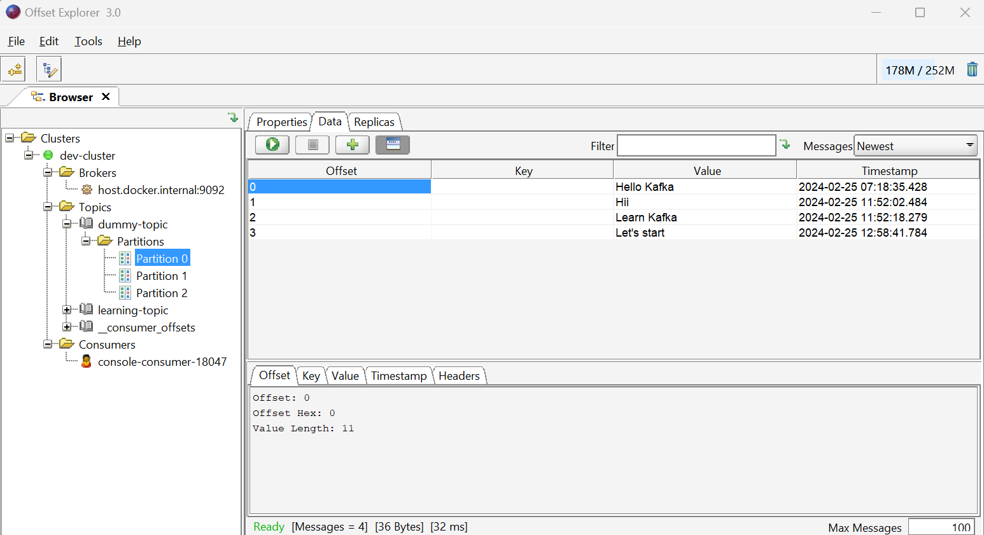

Slide 34
Bulk Push
Push bulk messages using CSV file.
type C:\demo\pushMessages.csv | .\bin\windows\kafka-console-producer.bat --broker-list localhost:9092 --topic dummy-topic
type C:\demo\pushMessages.csv reads the contents of the CSV file.
| (pipe) sends the output of the type command as input to the kafka-console-producer.bat script.
.\bin\windows\kafka-console-producer.bat is the path to the Kafka console producer script.
--broker-list localhost:9092 specifies the Kafka broker(s) to which messages will be produced.
--topic dummy-topic specifies the name of the Kafka topic to which messages will be produced.

Slide 35
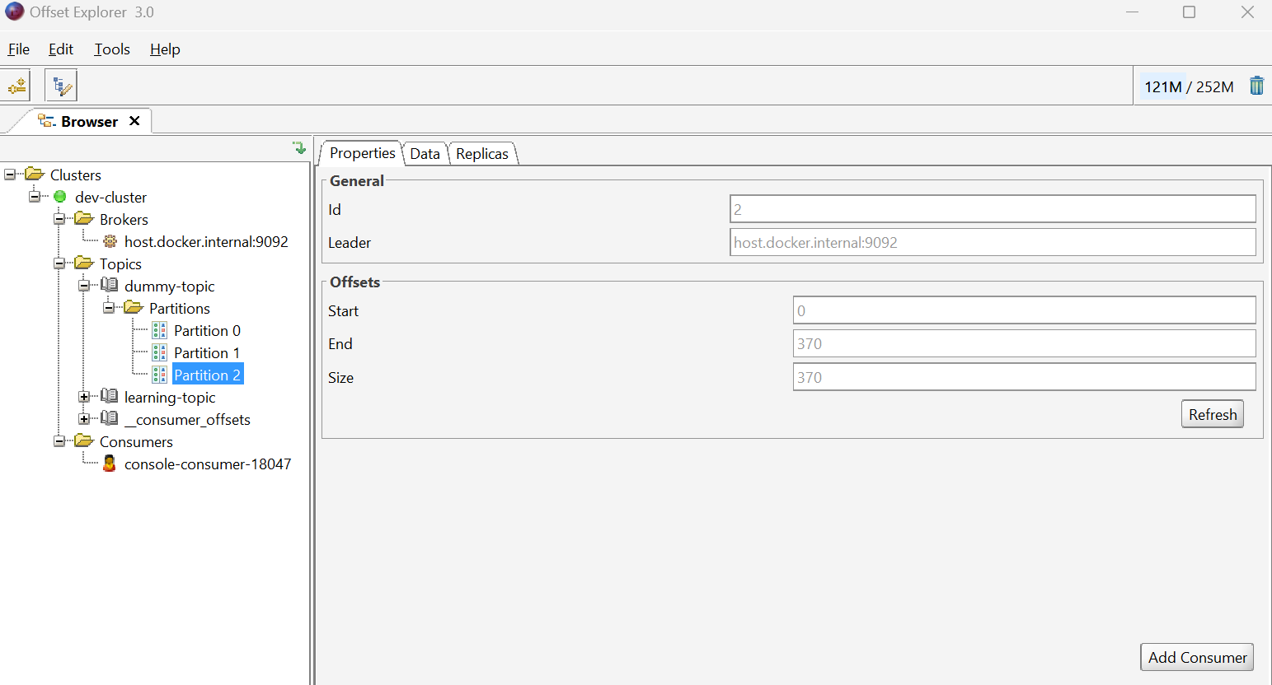
Message in all Partitions

Slide 36
Demo-2: Kraft Mode
No need to insert Kafka-cluster related meta-data into zookeeper, rather we can store it in kafka topic partition itself in kafka server. [After version 2.8 onwards.]
To run Kafka without zookeeper, run in “kraft” mode. [kafka_2.13-3.5.0\config\kraft]
Generate a Cluster UUID
KAFKA_CLUSTER_ID=$(.\bin\windows\kafka-storage.bat random-uuid)
Format Log Directories
.\bin\windows\kafka-storage.bat format -t %KAFKA_CLUSTER_ID% -c config\kraft\server.properties
Start the Kafka Server
.\bin\windows\kafka-server-start.bat .\config\kraft\server.properties
Once the Kafka server has successfully launched, you will have a basic Kafka environment running and ready to use.
NOTE: After 3.5 version, it’s recommended to use KRAFT mode in production environments. After version 4.0 onwards, zookeeper will not be supported/provided by kafka.

Slide 37
DEMO-3: Kafka setup using Docker
Install Docker and check docker and docker-compose version.
Create docker compose file to install both Kafka and zookeeper. [GIT*]
Run: docker compose –f docker-kafka-compose.yaml up –d
Check: docker images
Run: docker exec -it kafka /bin/sh
Check commands: ls, cd opt etc. [check kafka bin folder etc.]
Create a Topic, push message using producer and read using consumer.
kafka-topics.sh --bootstrap-server localhost:9092 --create --topic NewTopic --partitions 3 --replication-factor 1
Check in offset explorer.
Publish/push the message
kafka-console-producer.sh --broker-list localhost:9092 --topic NewTopic
Consume the message
kafka-console-consumer.sh --bootstrap-server localhost:9092 --topic NewTopic --from-beginning

Slide 38
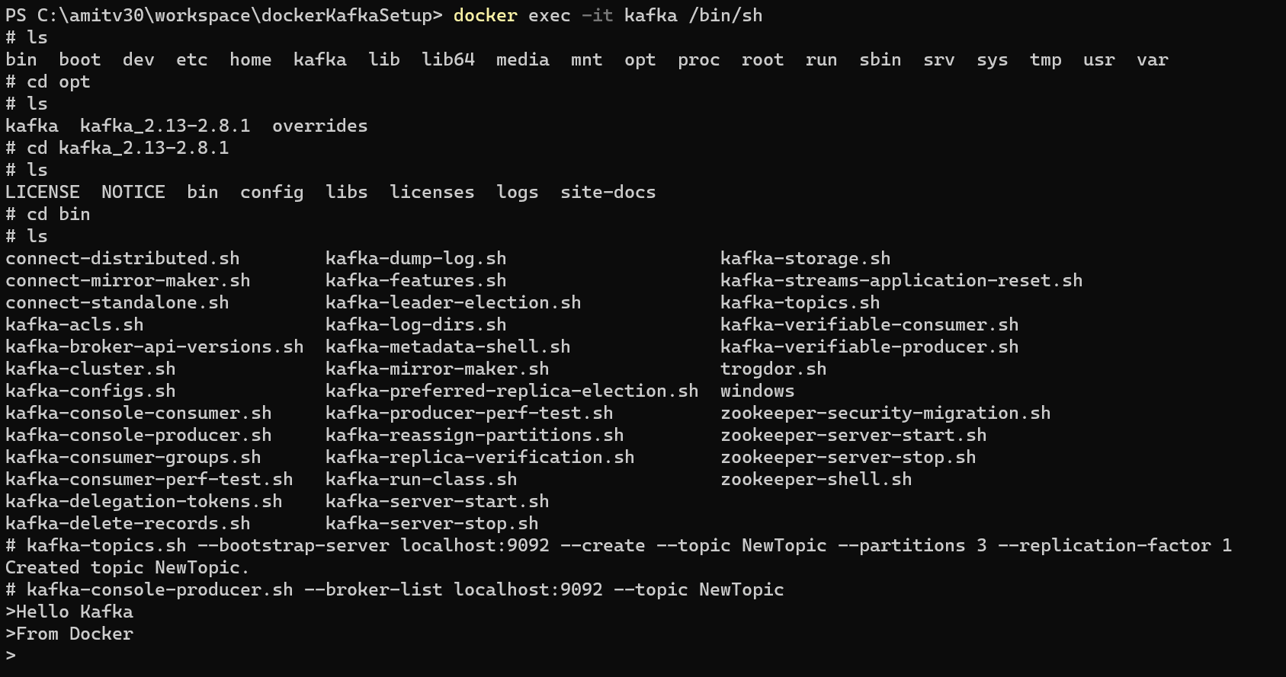

Slide 39
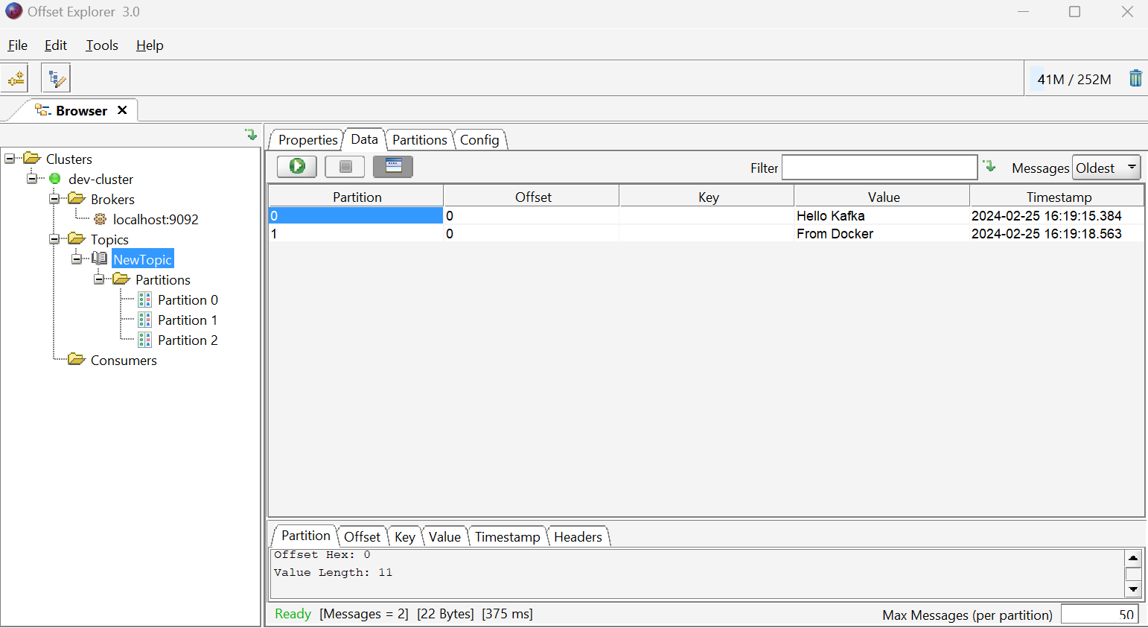

Slide 40
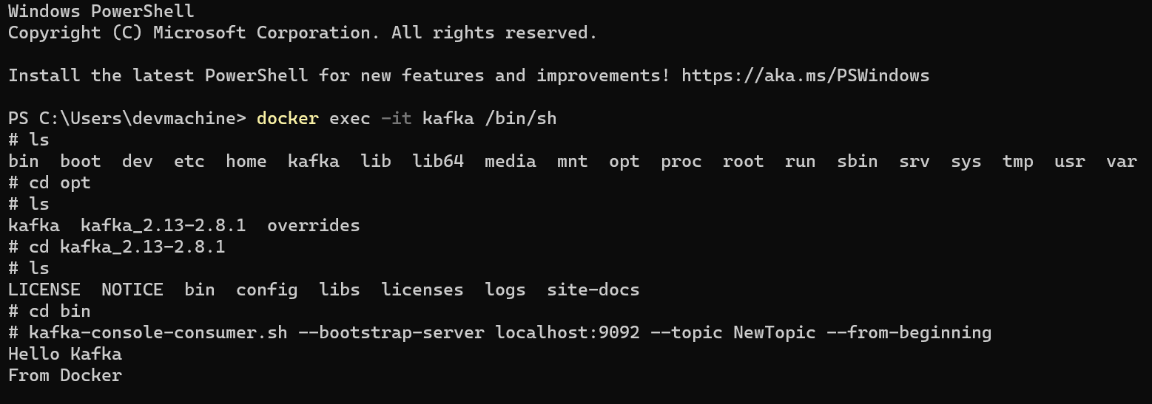

Slide 41
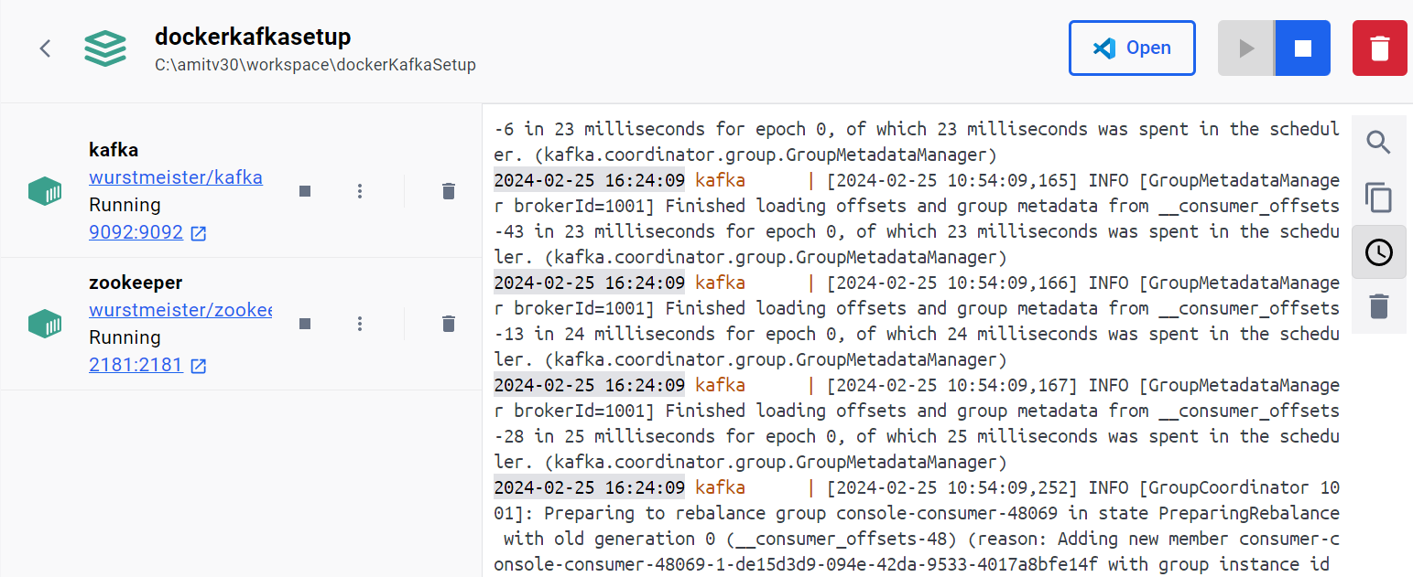
Docker Desktop

Slide 42
Ex: https://stackoverflow.com/questions/61947969/kafka-connector-always-works-as-a-single-task
Refer: https://www.youtube.com/watch?v=xGwzuz8F9k0&list=PLVz2XdJiJQxwpWGoNokohsSW2CysI6lDc
Debezium: https://medium.com/nagoya-foundation/simple-cdc-with-debezium-kafka-a27b28d8c3b8
https://www.youtube.com/watch?v=Y83O0_7OKb4&list=PLVz2XdJiJQxwpWGoNokohsSW2CysI6lDc&index=3
GUI Tools: https://www.reddit.com/r/apachekafka/comments/x9sov2/a_list_of_gui_tools_for_working_with_apache_kafka/
Kafka Tools: https://www.kafkatool.com/documentation/docindex.html
Online CSV: https://extendsclass.com/csv-generator.html

